Slide 1
EE 362: SUBSTATION & TRANSMISSION LINE DESIGN
Section 2:
SYSTEM EARTHING
Dr. E. K. ANTO

Slide 2
Section 2: Outline of Presentation
DEFINITION, general types and purposes of earthing
HAZARD VOLTAGES (step and touch potentials)
NEUTRAL EARTHING ARRANGEMENTS (isolated/ungrounded, solid, impedance, resonant/arc-suppression/Peterson earthing)
GROUND ELECTRODE RESISTANCE (effect of ground rod size and depth on resistance; effect of soil resistivity on ground electrode resistance)
NEED FOR EARTH/SHIELD/STATIC (ESS) WIRE or overhead earth wire (OHEW)

Slide 3
DEFINITION OF EARTHING

Slide 4
2.1: Definition of earthing (1/1)
DEFINITION of earthing:
the method of connecting the non-current carrying parts / frame / metallic body of an electrical equipment to earth or
the method of connecting the neutral/star point of the supply system to earth through a wire of negligible resistance

Slide 5
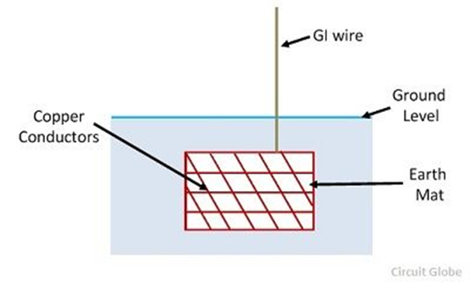
2.1: Definition of earthing (1/2)
Earthing can be achieved by: electrically connecting the respective parts in the installation to an
earth mat (system of copper conductors) or
electrode
placed near the soil or below the ground level.

Slide 6
GENERAL TYPES AND PURPOSES OF EARTHING

Slide 7
2.2: General types and purposes of earthing (1/2)
General types of earthing (1) Equipment Earthing and (2) System Earthing
EQUIPMENT EARTHING –
It is also called general earthing, and
deals with the earthing of non-current carrying parts (frame or metallic body) of the electrical equipment
PURPOSES of equipment earthing:
ensure safety of personnel from electric shock
protect the equipment from lightning strokes and earth fault conditions
provide easy path for the fault or leakage current to flow through it to earth

Slide 8
2.2: General types and purposes of earthing (2/2)
SYSTEM EARTHING –
It is also called neutral earthing,
It involves the connection of star-connected, 3-phase windings of transformers, motors, generators,…etc., to earth through a low resistance wire.
PURPOSES of system earthing
provide safety of equipment and personnel against lightning and voltage surges
provide discharge path for surge arrestors, gaps and other similar devices
provide means of positively discharging and de-energizing feeders or equipment before undertaking maintenance works on them

Slide 9
HAZARD VOLTAGES

Slide 10
2.3: Hazard Voltages (1/5)- Step and Touch Potentials
On the occurrence of a fault to earth, the value of the resultant earth fault current will depend on the following three factors:
1. phase voltage
2. neutral earthing arrangement of the system and
3. local earthing resistance between the metallic frames and earth.
The flow of the ground fault current results in voltage gradients on the surface of the earth in the vicinity of the grounding system as shown overleaf
It leads to TWO TYPES of hazard voltages, namely,
step potential and
touch potentials

Slide 11
2.3: Hazard Voltages (2/5)– Step and Touch Potentials (2)

Slide 12
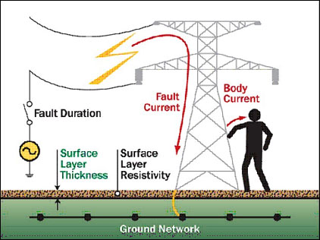
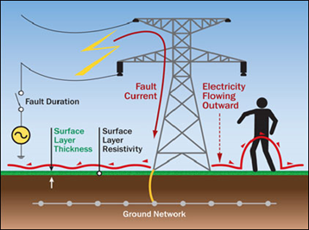
2.3: Hazard Voltages (3/5)– Step and Touch Potentials (3)
TOUCH POTENTIAL
STEP POTENTIAL

Slide 13


2.3: Hazard Voltages (4/5)– Step and Touch Potentials (4)
STEP POTENTIAL is the voltage that exists between the two feet of a person as he takes a step around an energized ground object
TOUCH POTENTIAL is the voltage that exists between the hand and both feet of the person upon touching a faulted energized object.

Slide 14
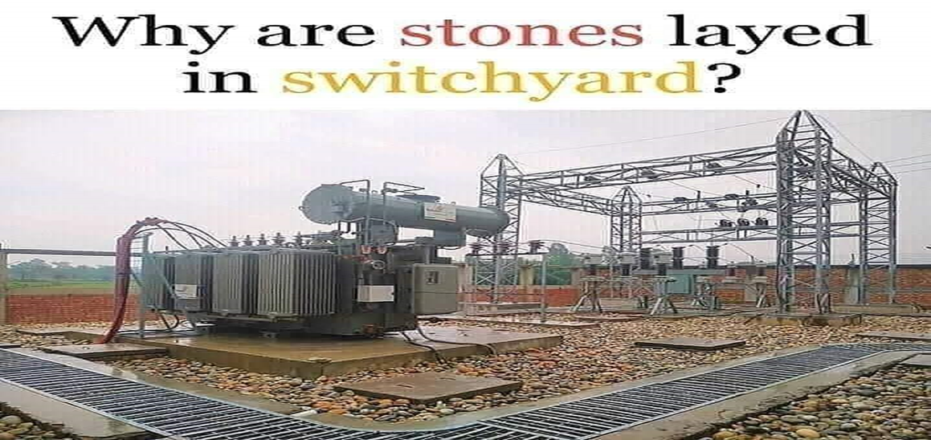
2.3: Hazard Voltages (5/5) – Step and Touch Potentials (5) – REDUCTION MEASURES
MEASURES FOR REDUCING THE HAZARD POTENTIALS
high insulation layer between personnel and ground
increasing fault path resistance (wear special boots, use of high resistance materials like gravels/stones at site)
The stones/gravels have very high resistivity (about 3,000 ohm-meter)
Consequently, they help reduce the hazard potentials significantly at the sites
proper placing of earthing/ground conductors

Slide 15
NEUTRAL EARTHING ARRANGEMENTS

Slide 16
2.4: Neutral earthing arrangements
Consider the earthing impedance as:
FOUR (4) neutral earthing or GROUNDING ARRANGEMENTS for the neutral points of MV/HV electrical systems:
Isolating the neutral entirely ( ); no physical connection to ground
Solidly or direct earthing ( )
Impedance earthing ( )
Arc suppression or Peterson-coil earthing ( )

Slide 17
ISOLATED/UNGROUNDED SYSTEMS

Slide 18
2.4.1: ISOLATED/UNGROUNDED Systems (1/2)

Slide 19
2.4.1.1: Consider GROUND FAULT ON SAY, PHASE B of an Isolated System, CURRENT DISTRIBUTION (1/3)

Slide 20
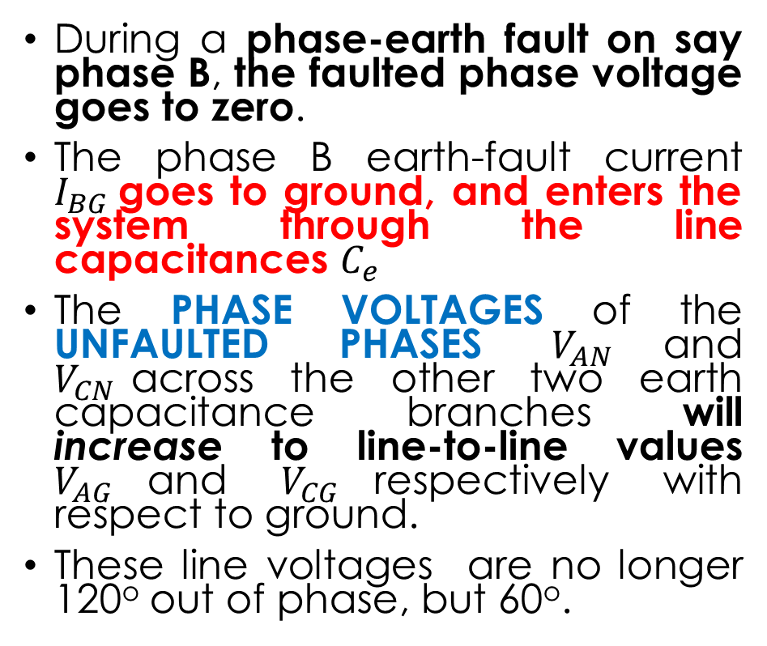
2.4.1.1: Consider GROUND FAULT ON SAY, PHASE B of an Isolated System, CURRENT DISTRIBUTION (2/3)
During a phase-earth fault on say phase B, the faulted phase voltage goes to zero.
The phase B earth-fault current $I_{BG}$goes to ground, and enters the system through the line capacitances $C_{e}$
The PHASE VOLTAGES of the UNFAULTED PHASES $V_{AN}$and $V_{CN}$across the other two earth capacitance branches will increase to line-to-line values $V_{AG}$and $V_{CG}$respectively with respect to ground.
These line voltages are no longer 120º out of phase, but 60º.

Slide 21
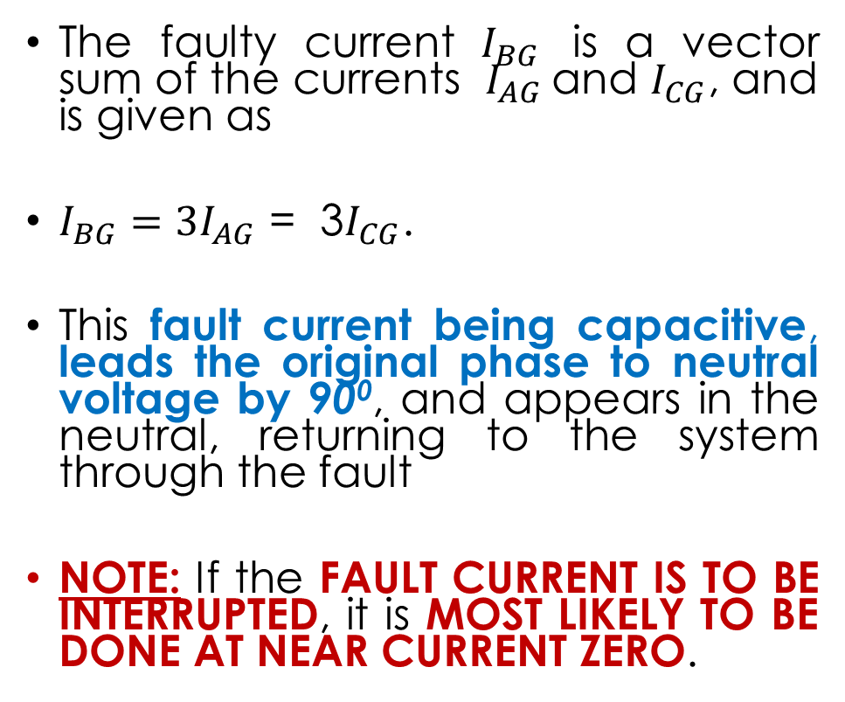
2.4.1.1: Consider GROUND FAULT ON SAY, PHASE B of an Isolated System, CURRENT DISTRIBUTION (3/3)
The faulty current $I_{BG}$ is a vector sum of the currents $I_{AG}$and $I_{CG}$, and is given as
$I_{BG}={3I}_{AG}$ = 3$I_{CG}$.
This fault current being capacitive, leads the original phase to neutral voltage by 90⁰, and appears in the neutral, returning to the system through the fault
NOTE: If the FAULT CURRENT IS TO BE INTERRUPTED, it is MOST LIKELY TO BE DONE AT NEAR CURRENT ZERO.

Slide 22
ARCING GROUND PHENOMENON

Slide 23

2.4.1.2: Arching Ground phenomenon (1/1)
However, since the current leads by 90⁰ in the capacitive circuit, current zero occurs at the instant of a voltage maximum.
Thus, in an attempt to momentarily clear the capacitive fault current, a high voltage is likely to appears across the fault, and a restrike of the fault will probably occur.
This is the so-called phenomenon of ARCING GROUNDS.
Theoretically, the earth-fault current in a phase-earth fault is given as
= fault resistance
= earth capacitance of one phase
= phase-earth voltage before the fault

Slide 24
MERITS AND DEMERITS
OF AN ISOLATED SYSTEM

Slide 25
2.4.1.3: Merits of an Isolated System
Operating a system with the neutral isolated results in low values of earth-fault current equal to the system capacitance current.
The voltage between faulted equipment and earth is consequently small, which improves safety.
The voltages of the healthy phases are unaffected by a ground fault, thus avoiding outages of healthy phases

Slide 26
2.4.1.4: Demerits of an Isolated System
(1) There exists the high probability of arc restrike when interrupting the fault current.
(2) And this can lead to the phenomenon of unsafe buildup of transient overvoltages in the system (arcing grounds), which is very dangerous to both personnel and equipment.

Slide 27
SOLIDLY-GROUNDED SYSTEMS

Slide 28
2.4.2: SOLIDLY-GROUNDED SYSTEMS: Phase B earth fault, CURRENT DISTRIBUTION (1/3)

Slide 29
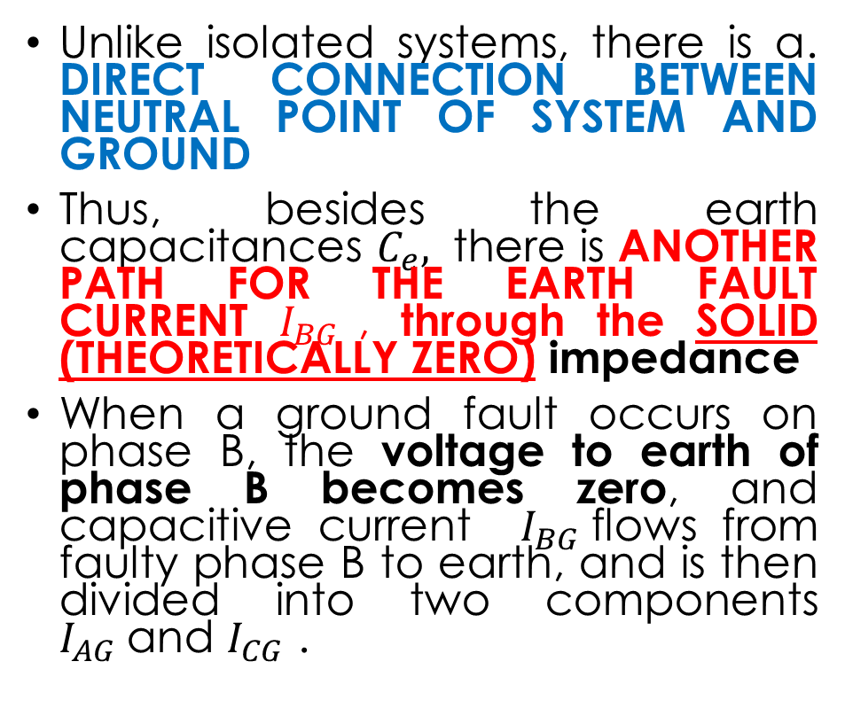
2.4.2: SOLIDLY-GROUNDED SYSTEMS: Phase B earth fault, CURRENT DISTRIBUTION (2/3)
Unlike isolated systems, there is a. DIRECT CONNECTION BETWEEN NEUTRAL POINT OF SYSTEM AND GROUND
Thus, besides the earth capacitances $C_{e},$ there is ANOTHER PATH FOR THE EARTH FAULT CURRENT $I_{BG}$, through the SOLID (THEORETICALLY ZERO) impedance
When a ground fault occurs on phase B, the voltage to earth of phase B becomes zero, and capacitive current $I_{BG }$flows from faulty phase B to earth, and is then divided into two components $I_{AG}$and $I_{CG}$ .

Slide 30

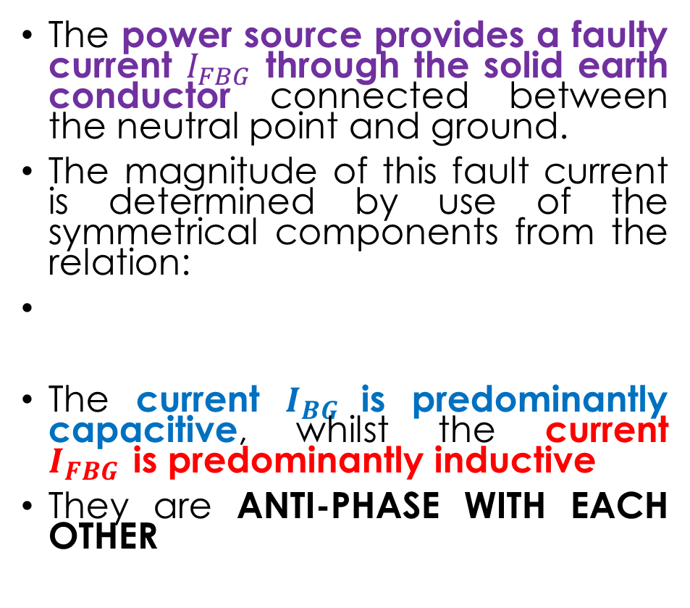
2.4.2: SOLIDLY-GROUNDED SYSTEMS: Phase B earth fault, CURRENT DISTRIBUTION (3/3)
The power source provides a faulty current $I_{FBG }$through the solid earth conductor connected between the neutral point and ground.
The magnitude of this fault current is determined by use of the symmetrical components from the relation:
The current $I_{BG }$is predominantly capacitive, whilst the current $I_{FBG }$is predominantly inductive
They are ANTI-PHASE WITH EACH OTHER

Slide 31
MERITS AND DEMERITS
OF A SOLIDLY-GROUNDED SYSTEM

Slide 32
2.4.2.1: Merits of a Solidly-grounded System
It is simple, inexpensive and requires no extra equipment.
The neutral point is held at earth potential under all operating conditions, and hence phase voltage for the healthy phases remain unchanged.
Because of the near constancy of the phase voltages, there is no need to over-insulate (since that costs money) as a measure against insulation breakdown in the event of an earth fault.
On HV systems (132 kV and above), additional savings are available, because for instance, transformer windings with graded/normal insulation can be used.
There is reduction of hazard voltages to acceptable levels
The protection of the system is simplified by virtue of the fact that the ground fault current compares in magnitude with inter-phase fault currents.
NOTE: Because of the above reasons, SOLID EARTHING IS MOST SUITED FOR HV SYSTEMS

Slide 33
2.4.2.2: Demerits of a Solidly-grounded System
A solidly grounded system produces the greatest magnitude of fault current when a ground fault occurs
The increased ground fault current results in greater influence (interference) on neighboring communication circuits.
The increased ground fault current produces more conductor heating/burning.
Any third harmonic currents that may circulate between neutrals tend to be additive and hence excessive, that is, excessive neutral current.

Slide 34
IMPEDANCE-GROUNDED SYSTEMS

Slide 35
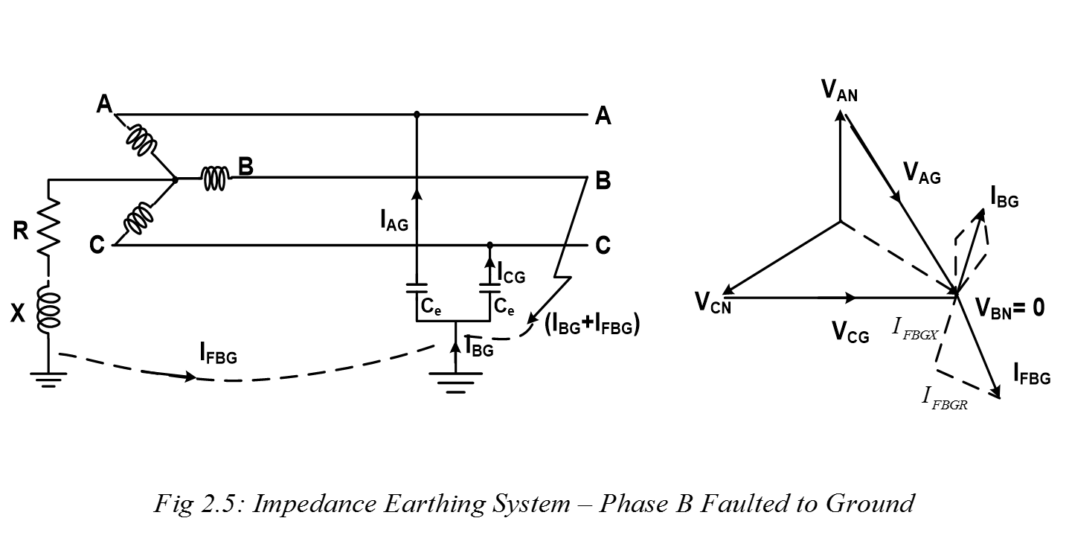
2.4.3: IMPEDANCE-GROUNDED SYSTEMS: Phase B earth fault, CURRENT DISTRIBUTION (1/2)
Impedance earthing involves connecting an “impure” resistor or reactor between the system neutral point and earth.

Slide 36
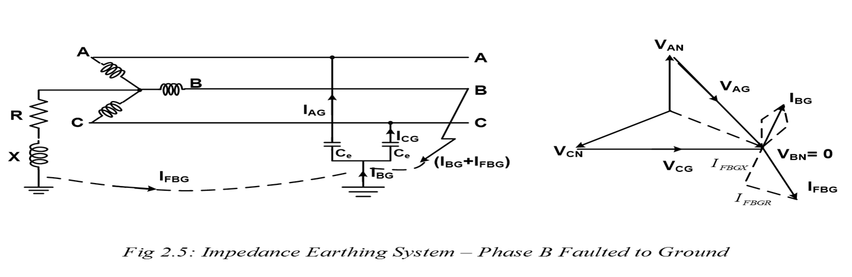





2.4.3: IMPEDANCE-GROUNDED SYSTEMS: Phase B earth fault, CURRENT DISTRIBUTION (1/3)
The fault current can be resolved into two components,
one being in phase with the voltage to neutral of the faulty phase and
the other lagging it by 90 deg
The lagging component of the fault current will be in direct phase opposition (anti-phase) to the resultant capacity current at the fault location.

Slide 37
MERITS AND DEMERITS
OF AN IMPEDANCE-GROUNDED SYSTEM

Slide 38
2.4.3.: Merits of impedance-grounded Systems:
It minimizes the hazard of arcing grounds (only in case of low resistance value)
The ground fault currents are reduced
It improves system stability under ground fault conditions.
It reduces momentary line voltage dip by clearing of ground fault.
It minimizes stray ground fault currents for personnel safety
NOTE: Due to above reasons, IMPEDANCE GROUNDING IS MOST SUITED FOR LV SYSTEMS

Slide 39
2.4.3.2: Demerits of impedance-grounded Systems:
The phase-earth voltage of the healthy phase increases; can reach √𝟑 times the normal value under earth-fault conditions, and occasionally some 5% higher, depending on the system 𝑅∕X ratios.
It gives rise to system neutral displacement or offset during ground fault,
The neutral displacement also leads to voltage variations (higher or lower values) in the healthy phases
The need to provide earth-current limiting device (resistor or reactor) means extra investment cost in the system
The inductive nature of the impedance earthing is of particular disadvantage with overhead lines exposed to lightning, since traveling lightning waves or impulses are subject to positive wave reflection

Slide 40
RESONANCE-GROUNDED/ARC-SUPPRESSION/PETERSON-COIL SYSTEMS

Slide 41
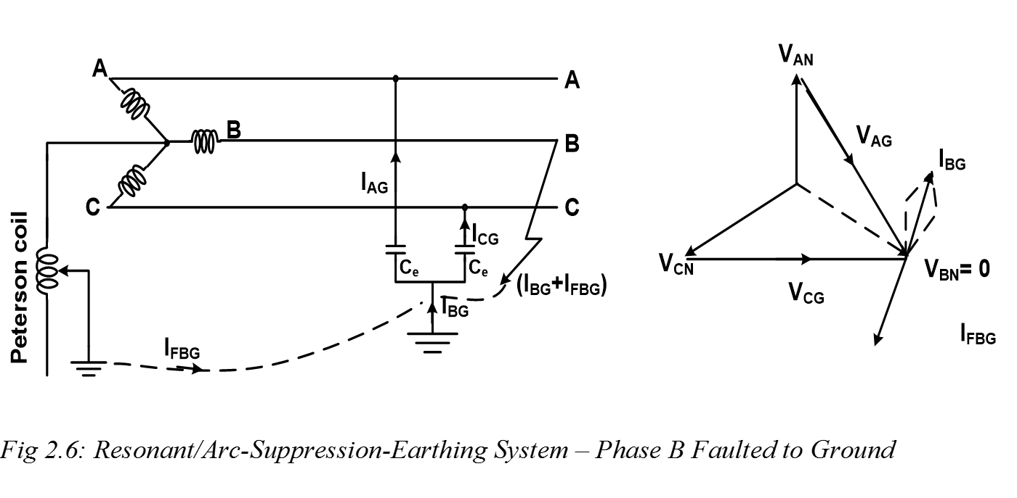
2.4.4: Resonant-grounded / Arc-Suppression-coil / Peterson-coil Systems: Phase B earth fault (1/2)
This method uses the ARC-SUPPRESSION-COIL, also called PETERSON COIL, and attempts to eliminate the fault current that could cause the arcing ground condition
Because the resultant earth fault current is very small, the associated touch or step voltage is also small, so that most systems could be operated for long periods with a sustained fault until the fault can be cleared

Slide 42
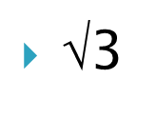



2.4.4: Resonant-grounded / Arc-Suppression-coil / Peterson-coil Systems: Phase B earth fault (2/2)
Voltage to earth of the faulty phase at the point of fault becomes zero.
Healthy phases voltages are is increased to times the normal value.
A resultant capacity current equal to three times the normal line to neutral charging current flows through the fault
Voltage of the faulty phase, i.e., phase voltage, is impressed across the arc suppression coil
A fault current restricted in magnitude by the impedance of the coil, flows through the faulted conductor, lagging the voltage of the faulty phase by 90 deg.
The capacity current and the fault current are in direct phase opposition.
Hence the FAULT CURRENT IS TOTALLY QUENCHED OR SUPPRESSED.

Slide 43
DETERMINATION OF INDUCTANCE
OF PETERSON-COIL

Slide 44



2.4.4.1: Determination of inductance of arc-suppression-coil
The capacitive current is three times the normal phase to neutral current.
Thus
And so for resonant grounding,
Thus THE INDUCTANCE IS:
Where is the capacitance of each sound conductor to earth.

Slide 45
GROUND OR EARTH RESISTANCE

Slide 46
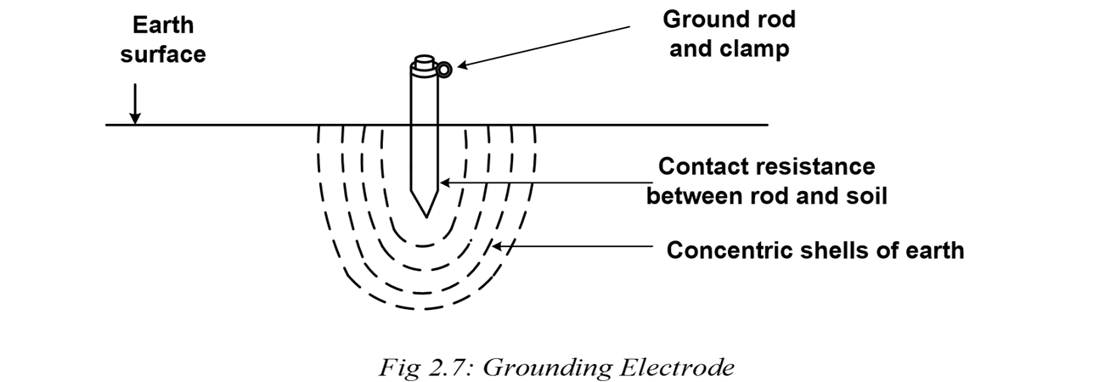
2.5: Ground or Earth Resistance (1/2)
The term “earth or ground” is defined as a conducting connection by which a circuit or equipment is connected to earth.
A “ground” consists of a:
grounding conductor,
bonding connector,
its grounding electrode(s) and
soil in contact with the electrode.

Slide 47
2.5: Ground or Earth Resistance (2/2)
Ideally, an earth resistance should be zero, in order to:
maintain a reference potential for instrument safety,
protect against static electricity and
limit the equipment ground voltage for operator safety
In reality, this value cannot be achieved.
However, low earth resistance is required by electrical safety codes and standards.

Slide 48

2.5.1: Ground Electrode Resistance (1/2)
The resistance of the earthing is made up of the following components:
1. Resistance of the electrode itself and that of the connection to it.
2. Contact resistance of the surrounding earth to the electrode.
3. Resistance of the earth immediately surrounding the grounding electrode or resistivity of earth, which is often the most significant factor.

Slide 49
2.5.1: Ground Electrode Resistance (2/2)
The electrode can be thought of as being surrounded by concentric shells of earth or soil, all of the same thickness.
The closer the shell to the electrode, the smaller its surface; hence the greater its resistance.
The farther away the shells are from the electrode, the greater the surface of the shell; hence the lower the resistance.

Slide 50
EFFECT OF ROD SIZE AND DEPTH
ON RESISTANCE

Slide 51
2.5.2: Effect of Ground Rod Size and Depth on Resistance (1/3)
Effect of rod SIZE:
INCREASING THE DIAMETER of the rod, DOES NOT MATERIALLY REDUCE ITS RESISTANCE.
It’s found out that, doubling the diameter of the ground rod reduces resistance by less than 10%.
A minimum diameter of 5/8 in (1.59 cm) is required for steel rods, and 1/2 in (1.27 cm) for copper or copper clad steel rods.
Minimum (STANDARD) PRACTICAL DIAMETERS for driving limitations for 10 ft (3 m) rods are:
•1/2 in (1.27 cm) - in average soil
•5/8 in (1.59 cm) - in moist soil
•3/4 in (1.91 cm) - in hard soil or more than 10 ft driving depths.

Slide 52
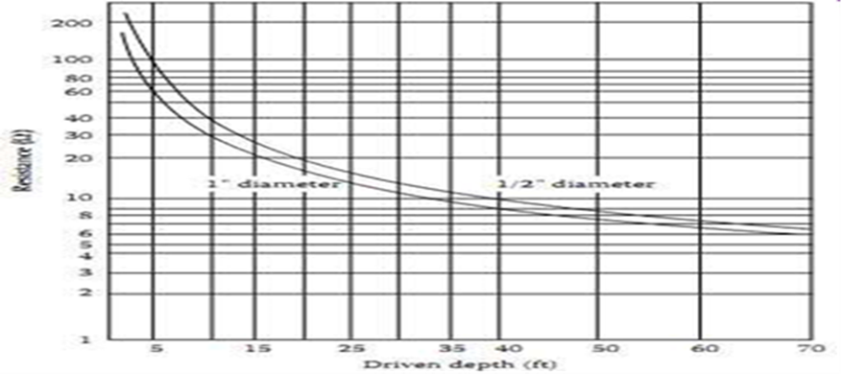
2.5.2: Effect of Ground Rod Size and Depth on Resistance (2)
Effect of DEPTH of rod
Comments:
As a ground rod is driven deeper into the earth, its resistance is substantially reduced, but only up to point, AND THEN LEVELS OFF
The NEC code requires a minimum of 8 ft (2.4 m) to be in contact with the soil.
The most common is a 10 ft (3 m) cylindrical rod that meets the requirements of the code.

Slide 53
FACTORS AFFECTING SOIL RESISTIVITY

Slide 54
2.5.2: Effect of Ground Rod Size and Depth on Resistance (3/3) – FACTORS AFFECTING SOIL RESISTIVITY
Soil resistivity is the key factor that determines what the resistance of a grounding electrode will be, and to what depth it must be driven to obtain low ground resistance.
Soil resistivity is DETERMINED LARGELY BY ITS CONTENT OF ELECTROLYTES, consisting of moisture, minerals and dissolved salts
A dry soil has high resistivity if it contains no soluble salts.
Soil resistivity is also INFLUENCED BY TEMPERATURE.
The National Electric Code (NEC) code states that the resistance to ground shall not exceed 25 ohm.
The lower the ground resistance, the safer.

Slide 55
TYPICAL GROUNDING RESISTANCE VALUES

Slide 56
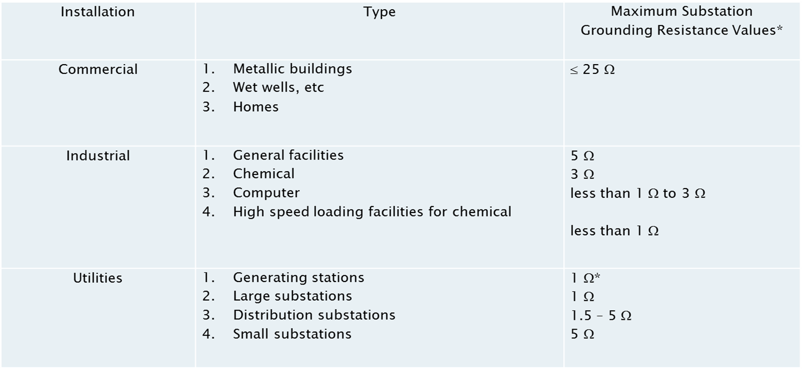
2.6: Typical Grounding Resistance Values of Substations for Various Installations
Tower footing resistance should not be more than 10 ohm

Slide 57
NEED FOR OVERHEAD EARTH WIRE (OHEW)

Slide 58
2.7: Need for earth/shield/static (E/S/S) wire or overhead earth wire (OHEW)
In places where there is few or lack of lightning, many transmission lines may have no OHEW.
Lightning may flash insulators and strike directly the line conductor.
And so the OHEW offers the following advantages:
Protection for places with massive electrical storms and against direct lightning strikes.
They provide a superior earth path, in the case of phase to earth faults.
The OHEW also helps to even out the earthing systems on structures and keep the average resistance of the structures taken over a max of 3 to below 10 ohms or 5 ohms when within 5 km of a switchyard.
Protection/switchgear operating times can be improved (by reducing damage, improving discrimination and minimizing system instability).
The OHEW affords greater safety to operatives via employment of drain earthing schemes.
If the transmission line can also provide a valuable route for communication & control of the network, an Optical Ground Wire (OPGW) design is ideal

Slide 59
EXERECISES

Slide 60
2.8: EXERCISES (1/2)
Exercise 2.1
(a) With the aid of diagrams, explain the following:
step voltage
touch voltage
(b) With the aid of diagrams, explain the term “resonant grounding” as applied in systems grounding.
(c) Give TWO advantages and disadvantages EACH of ungrounded system earthing.
(d) With the aid of diagrams, show and explain the current distribution when a single phase-earth fault occurs in an “impedance grounded” power system
Exercise 2.2
(a) What is earthing? Give any TWO reasons why earthing is employed.
(b) With the aid of diagrams, show and explain the current distribution when a single phase-earth fault occurs in a “solidly grounded” power system.
(c) Give 2 advantages and disadvantages each of an “impedance grounding” in a power system.

Slide 61
2.8: EXERCISES (2/2)
Exercise 2.3
(a) Explain what earthing is. Give any TWO (2) reasons why earthing is employed.
(b) Explain (without diagrams) the terms step potential and touch potential as applied in earthing
(c) What do you understand by the term arcing grounds?
(d) With the aid of diagrams, show and explain the current distribution when a single phase-earth fault occurs in a solidly grounded power system.
(e) Give TWO (2) advantages and disadvantages EACH of solid grounding in a power system.
(f) Give a sketch relating the soil resistance and depth of penetration of the ground electrode, and briefly discuss.
(g) Mention any THREE (3) uses of the overhead earth wire (OHEW) in a power transmission system

Slide 62
End of Section 2

